Slide 1

Optimizing Causal Self-Attention on GPUs
Exploring Performance via Naive, Tiled, and Online-Softmax Kernels
GPU Specialization Capstone Project

Slide 2



Project Objectives
Core Mission
The Attention Formula
To implement, benchmark, and understand three distinct CUDA kernels for causal self-attention on a single attention head.
The standard scaled dot-product attention we are optimizing:
Implementation: Build Naive, Shared-Memory Tiled, and Fused Online-Softmax kernels.
Validation: Ensure numerical correctness against a CPU reference implementation.
*The project implements the causal variant, where attention is restricted to past and present tokens (lower triangular mask).
Benchmarking: Measure runtime performance across various sequence lengths and head dimensions.
Analysis: Understand why different GPU memory structures impact performance, moving beyond just proving they run.

Slide 3






The Three Kernel Architectures
1. Naive Baseline
2. Shared-Memory Tiled
3. Fused Online-Softmax
A simple 3-stage pipeline (Scores -> Softmax -> Output). It explicitly computes and stores the full N x N score matrix in global memory.
Improves the score computation stage by caching tiles of Queries (Q) and Keys (K) in fast on-chip shared memory.
Processes one query row at a time. Computes max and denominator incrementally across KV tiles, updating output in-place.
Reduces bandwidth, but still stores full score matrix globally.
FlashAttention concept. Avoids N x N global memory matrix.
Highly memory-bound.

Slide 4
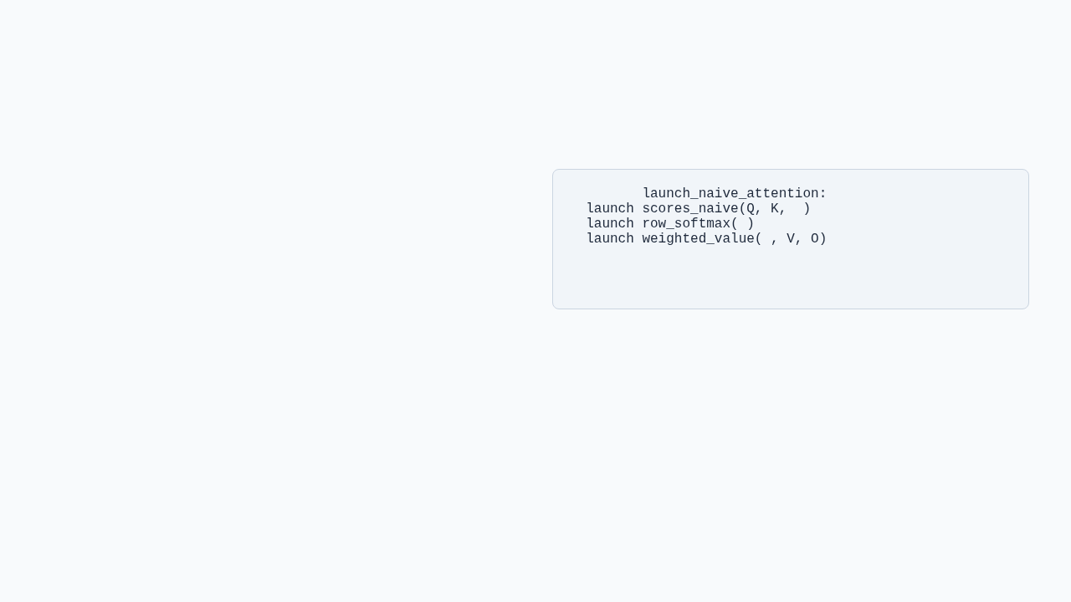

1. The Naive Pipeline
The naive approach is straightforward but highlights the memory bottleneck of standard attention.
function
S
S
S
Kernel 1 (scores_naive): Computes . Writes entire lower-triangular matrix to Global Memory.
// S is materialized in Global Mem
Kernel 2 (row_softmax): Reads S from Global Memory, applies stable softmax reduction using block-level shared memory, writes probabilities back.
Key Takeaway: Easy to verify correctness, but performance is crushed by Global Memory reads/writes for the score matrix.
Kernel 3 (weighted_value): Reads probabilities and Values (V), computes final .

Slide 5
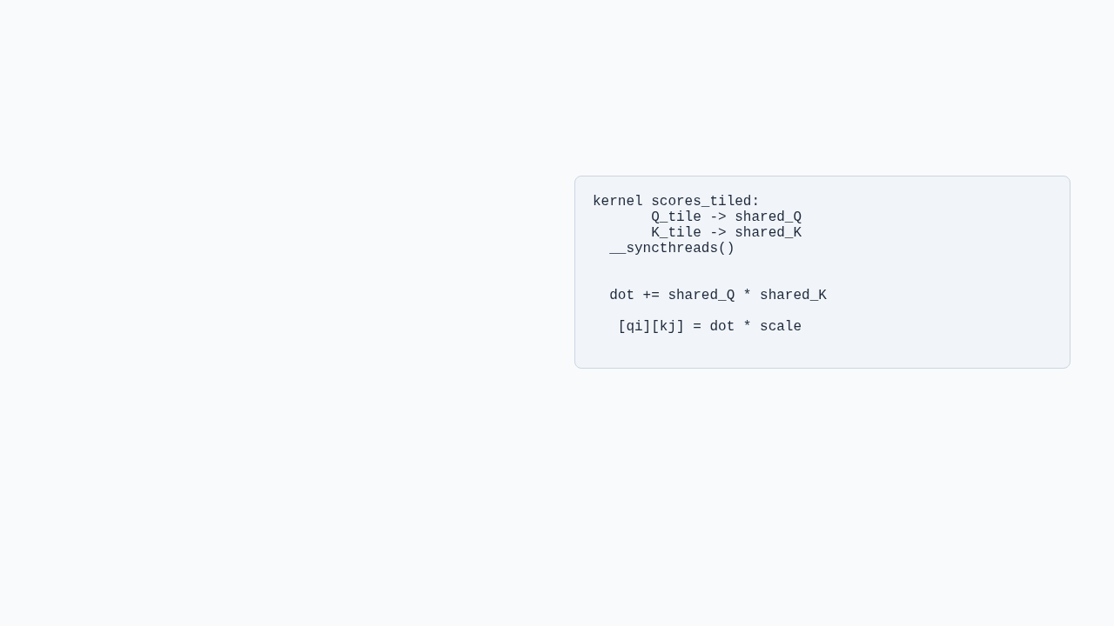
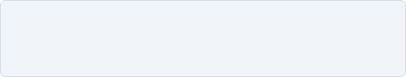
2. Shared-Memory Tiling
This stage introduces a central GPU optimization: reducing global memory traffic by caching data on-chip.
load
load
Maintains the 3-kernel pipeline structure.
// Compute from shared memory
Modifies the first kernel (scores_tiled).
S
Loads a TILE-by-d block of Q and a block of K into Shared Memory.
Key Takeaway: Reduces bandwidth pressure for Q and K, but still materializes the full S matrix. It isolates the benefit of tiling from the benefit of fusion.
Threads compute dot products from Shared Memory instead of repeatedly fetching from Global Memory.

Slide 6

3. Fused Online-Softmax
The most conceptually demanding kernel. It embodies the algorithmic improvement behind FlashAttention.
Online Softmax Recurrence
Single Kernel: Combines score, softmax, and value accumulation into one fused operation.
The output accumulator is scaled by the ratio of old/new denominators to remain correct as new tiles are processed.
Tile by Tile: Iterates over key/value tiles for a single query row (handled by one block).
Incremental Updates: Maintains running max and running denominator for stable softmax without seeing the whole row at once.
No N x N Matrix: Output is updated incrementally in place.

Slide 7


Testing & Benchmarking Harness
CPU Reference
CUDA Events
Error Checking
Computes ground-truth for one batchless problem. Crucial for verifying the complex logic of the GPU kernels.
Timing relies on CUDA events (start/stop) wrapped around multiple kernel iterations (after warmup) for stable averages.
Reports maximum absolute error against . Ensures numerical stability tricks (like tracking row max) are implemented correctly.

Slide 8

Conclusions & Lessons Learned
Correctness vs. Performance: Naive logic is easy to verify, but performant code requires complex structural changes.
Project Significance
Tiling Limits: Shared memory helps bandwidth, but doesn't solve the core issue if the intermediate state is still saved globally.
"This project moves past a basic CUDA demonstration... measuring behavior empirically, and including a fused attention kernel based on online softmax rather than a superficial parallelization."
The Power of Fusion: The Online-Softmax trick fundamentally changes memory requirements, enabling processing of longer sequences than previously possible on limited VRAM.
Math to Silicon: Translating mathematical formulas directly to CUDA often yields poor results; algorithms must be adapted to hardware constraints.

Slide 9
Q&A
Thank you for your time.
GitHub: github.com/strawhat234567/GPUCapstone

